Slide 1


Incremental Learning with Support Vector Machines on Embedded Platforms
Master Thesis - Final Talk
Shankar Kumar
Computer Engineering Group, Paderborn University
shanks@mail.upb.de
Notes:
A very good afternoon to everybody here, I would like to invite you to my final talk as part of my Master’s thesis, which has been a fun and educational journey, titled Incremental Learning with Support Vector Machines on Embedded Platforms. ..

Slide 2







Motivation
In house Machine Learning is a necessity
Growing number of embedded devices with intelligence in them
Training is resource hungry
Current focus only on acceleration of inference phase
Notes:
As a start I would like to state the four major pillars for the motivation of my thesis.
In this period of big data and machine learning, we see that machine learning is applied to nearly every field with a intent of solving day to day problems by machines in an intelligent way. Every industry and company is seeing a shift towards adapting machine learning into its products and with this comes the issue of data security. Why? When a company would like to involve in Machine Learning to better its products but does not have the necessary and expensive hardware and software resources want to outsource it’s data to 3rd parties to perform this learning for example cloud based services from google and amazon, which can result in data privacy concerns, this is where In house machine learning comes into picture. With this concept, A company is able to locally apply machine learning with its private data, without having to worry about security concerns that arise with outsourcing data.
The second point being, in today’s era of the internet of things, we can see a growing number of devices being connected to the internet and hence exchanging vast amounts of information with each other. With great power comes great responsibility, but this holds true for a data scientist who would say with large amounts of information comes larger possibilities/opportunities . So when we have such vast amounts of information, this lets us apply machine learning, which is essentially data driven, into the embedded devices themselves. But this comes at a cost and traditionally to enable machine learning on a device, it would require costly, resource hungry hardware. Wouldn’t it be an advantage to find better ways to allow machine learning algorithms to run on resource constrained environments such as smaller embedded systems for this purpose?
Speaking of Resource hungry, Machine learning essentially is a pattern recognition program that sifts through given data and finds a pattern amongst it and stores it as a model for further use. This process can be very resource intensive, usually running hot and hungry for hours to days at a stretch. Wouldn’t it be an advantage to simplify this training process, and also attempt at speeding it up? Reduce days to hours and hours to maybe minutes? With this current acceleration techniques usually focus on only speeding up the inference phase, after a resulting model that has been trained elsewhere on a powerful machine is stored only to be used for inference or prediction of the behavior of a system. Even if we look at the acceleration of the training phase, It is widely known that expensive GPUs are used for this purpose. This is in stark contrast to small scale embedded systems, which are pretty inexpensive when compared to GPUs and server based training systems.
Support vector machines fit out requirement for embedded machine learning being fast and light and hence we focus on them.

Slide 3

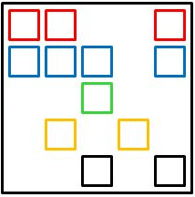
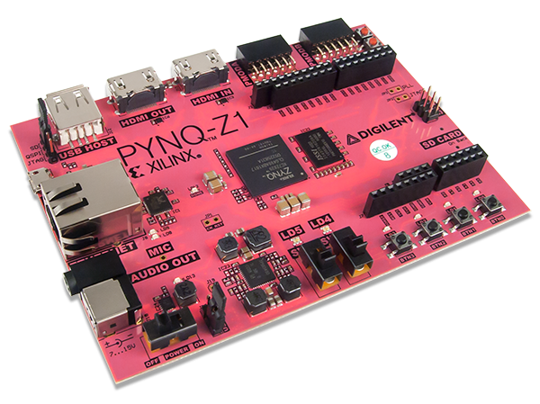
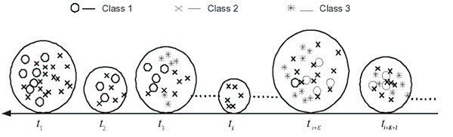
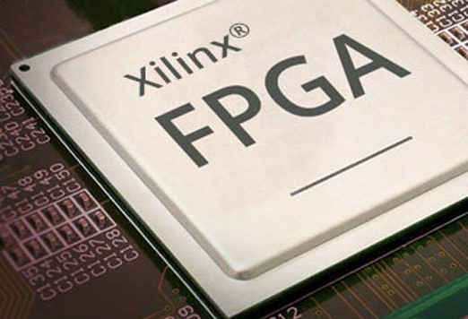
Objectives
SVM Implementation
Incremental / Online learning
Approximation Methods
Implementation on an Embedded Platform
Offload tasks to FPGA for acceleration
SMO
Notes:
To summarize the motivation into a set of objectives that were set for this thesis, The first stage was to implement the actual SVM algorithm, second being able to modify the algorithm such that it allows for incremental learning rather than feeding all training data at once which is not possible due to resource constraints of an embedded system. The third stage was to approximate the training phase, such a way that instead of blindly computing on all the entire dataset, we intelligently select which subsets of the data are attractive to use for training and which are redundant. The fourth stage was to then dry run this incremental and approximated algorithm on the chosen embedded system to find out or profile which parts of the algorithm were computationally intensive. The final stage was to then pick these computationally intensive parts and implement them to run on an FPGA instead of the CPU and hope that there is some amount of acceleration ☺ in the Training.

Slide 4
Outline
Introduction
Incremental Algorithms
Algorithm Evaluation Results
Hardware Accelerator Design
Hardware Acceleration Results
Conclusion and Future work
Notes:
Hence the rest of the talk is structured this way, I will give you a short introduction to support vector machines which follows from my initial talk nearly 7 months ago, Then we will proceed to look at the different incremental algorithms that we implemented and tested out, each of which will be bettering the disadvantages of its predecessor. We will weigh these against how well of each of the algorithms perform with respect to its classification accuracy. With a final chosen incremental and approximated SVM algorithm, we then look at the design of the FPGA based accelerator architecture suitable after having profiled the algorithm on a dry run. We then look at the results for CPU only vs FPGA accelerated implementation that ran of various commonly used datasets in the Machine Learning world. We will conclude with achievements of the thesis and the possible improvements for the future.

Slide 5
Support Vector Machines
This is what SVM does!
y
y
y
y
x
x
x
x
Notes:
Following my detailed introduction to support vector machines In my initial talk this is a brief recap. Imagine you have a dataset consisting of two labels, depicted in red and black. The idea for classification is to be able to differentiate both the labels by a linear separator efficiently. We could either do it this way or this way or this way. We can see that The third way seems to do an efficient job at separating the two classes with a maximum separation or margin. This is exactly what the SVM does and is also hence known as the maximum margin separating classifier. The points along the margin that are encircled are called the support vectors and hence the name support vector machines. These points are all that are needed to differentiate labels and not the entire dataset, which makes the SVM pretty memory efficient..

Slide 6
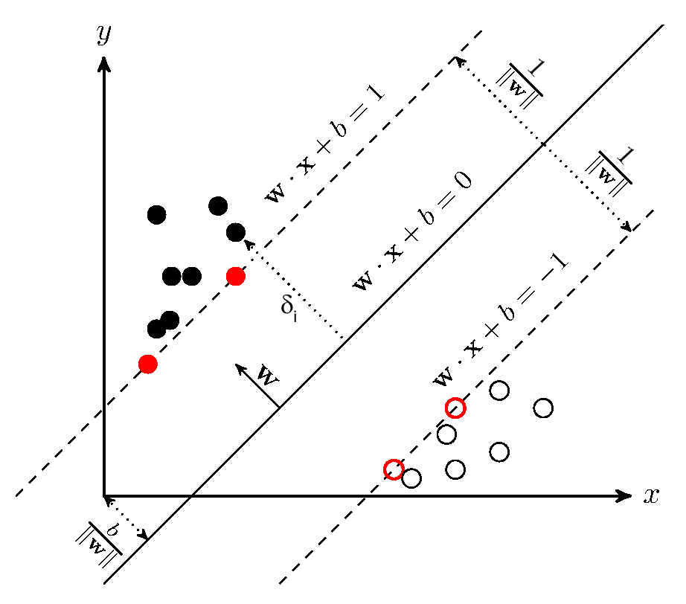




SVM Mathematical Formulation
margin
margin
w
= normal vector to the plane
= geometric distance from the origin
= minimize this to maximize the distance
= positive sample
= negative sample
Notes:
The w and b that solve this problem determine our classifier, sign of the corresponding solution denoted class/label

Slide 7
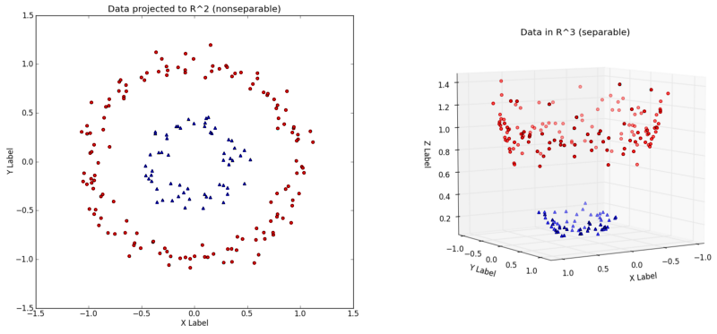

The Kernel Trick
Function
Original sample space
New feature space
Notes:
What is our data is not so easily linearly separable?, this is where the kernel trick comes into picture, which integrates smoothly into the SVM’s mathematical formulation. The kernel trick basically allows us to convert non linearly separable data in one dimension to hopefully be linearly separable in a higher dimension. The function that maps our data from a non separable lower dimension to a separable higher dimension is called the Kernel function. The Kernel function and the maximized margin are the two essential aspects of Support Vector Machines.

Slide 8

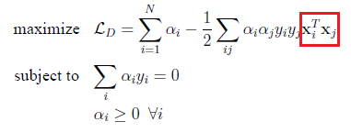

Constructing the SVM Problem
The problem state of SVM is a constrained optimization problem as follows:
Lagrange primal problem statement (above) but solved by the dual version of problem statement (below):
= Lagrangian Multipler
C = Penalty Hyperparameter
KKT Conditions:
This now reduces to a Quadratic Optimization problem
0 <
< C
Sample is a support Vector
= 0
Correctly labeled sample
= C
Incorrectly labeled sample
Notes:
Directly solving this problem is difficult because the constraints are quite complex. The mathematical tool of choice for simplifying this problem is the Lagrangian duality
Thus solving the SVM problem is equivalent to finding a solution to the KKT conditions

Slide 9
The Kernel Trick
“If an algorithm is described solely in terms of inner products in input space then it can be lifted into feature space by replacing occurrences of those inner products by K(x,x’); this is sometimes called the kernel trick.”
- Rasmussen and Williams, “Gaussian Processes for Machine Learning,” MIT press, 2006.
Φ(X_{i}) ^{T}. Φ(X_{j}) = K(X_{i}^{T},X_{j})

Slide 10
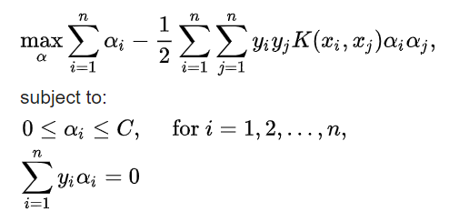

The SMO Algorithm
The dual version of SVM problem statement:
For any two multipliers α₁ α_{2,} the constraints are reduced to:
Reduces the problem to minimize a one-dimensional quadratic function.

Slide 11
Outline
Introduction
Incremental Algorithms
Support Vector Forwarding
Incremental Approximated Algorithms
Nearest Neighbor approximation
Misclassified samples only
Misclassified + marginal samples
Algorithm Evaluation Results
Hardware Accelerator Design
Hardware Acceleration Results
Conclusion and Future work
Notes:
Now that we have had a brief introduction to support vector machines, let us look at the 4 different incremental algorithms tested during the algorithm implementation phase of the Thesis.

Slide 12
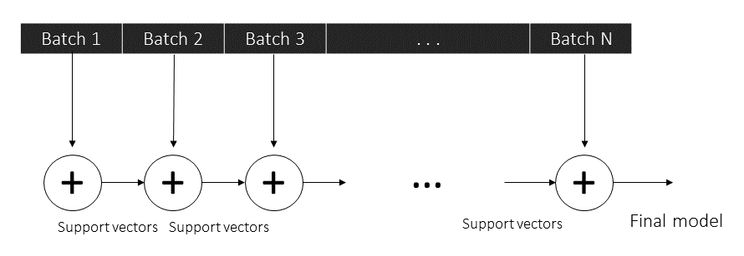
Support Vector Forwarding
Notes:
The most trivial form of Incremental learning widely used is dividing our dataset into a number of batches, and lets say that we train on our first batch, obtain a asset of support vectors from the present batch. We then proceed to forward these support vectors only and append them to the next batch of incoming data and subject this new batch of data to training. This way support vectors from every batch keep getting forwarded through out bathes unless a better set of support vectors replace a previous one.

Slide 13
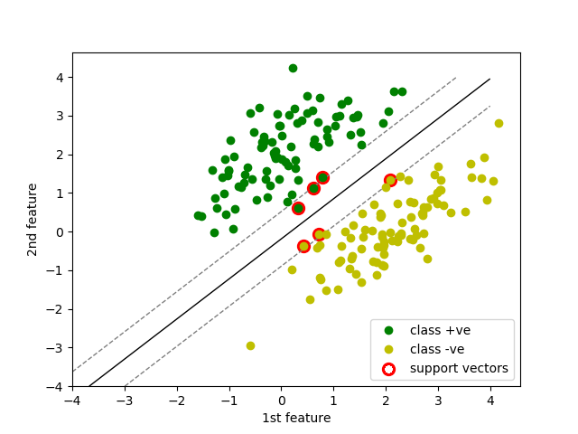
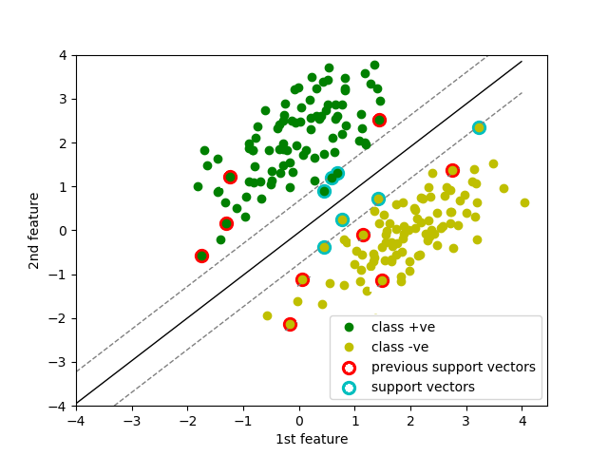
Support Vector Forwarding
Notes:
The results of this approach can be graphically seen here as an example for the linear case. The first image represents the result of training on the first batch of data and the points marked in red denote the resultant support vectors. On the right the second image depicts the second batch of data being subjected to svm training along with the presence of the support vectors from the previous batch. This continues until we have exhausted our batches. This method was considered as the baseline incremental algorithm against which the rest of the incremental and approximated methods are compared against. This method had the obvious disadvantage that after a certain point the number of support vectors keep increasing and hence the device would eventually run out of memory..

Slide 14
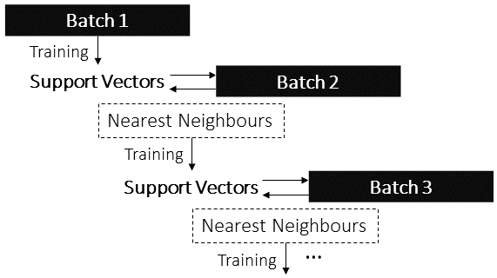
Nearest Neighbor Approximation
Notes:
As an initial attempt to sub sample the number of points we consider for training, we considered what is known as the nearest neighbor approximation technique. This follows from the fact that once the boundary or the margin of the SVM has been established, incoming points from the next batch of data that lies close to this established boundary or the support vectors, have a higher chance of altering the decision boundary rather than points that are further away. So the gist of this method being, we split our data into a number of batches, we train the SVM on an initial batch and obtain the support vectors from this initial batch. When the next batch comes in, we only select those points that might lie in the close vicinity of our previously obtained support vectors and discard the rest of the training samples.

Slide 15
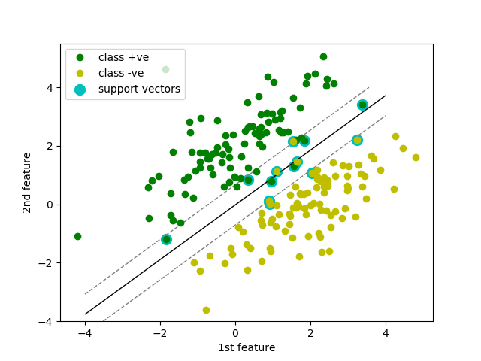
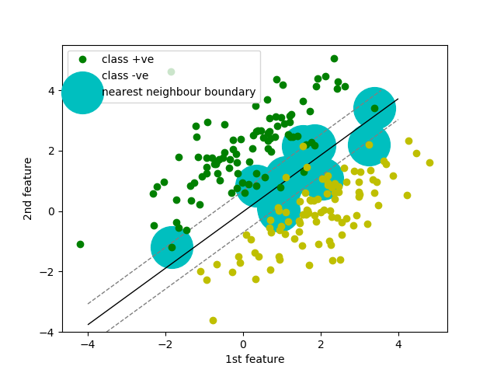
Nearest Neighbor Approximation
Notes:
The idea can be visualized as an example for the linear case. The figure on the left depicts the support vectors produced from the first batch of data as a result of training, encircled in turquoise. The figure on the right indicates the region bounding the support vectors from which we select only k number of nearest neighbors in the second batch of training data. This method was successful with one major draw back that if in a multi class system, if the labels were not uniformly distributed in the first batch, we would end up with a bias towards one set of points belonging to a label or our training data could consist of a more points from a label that had dense cluster near the support vectors. But this method did give rise to an idea for the final algorithm that will be discussed in the next slides.

Slide 16
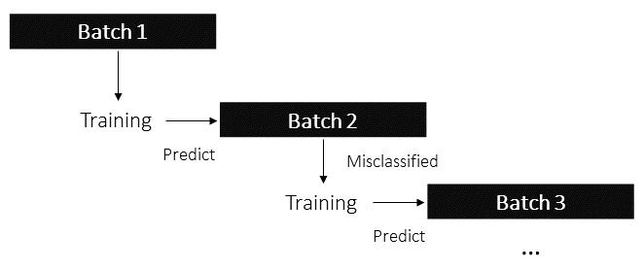
Misclassified Only
Notes:
The third method that we though about was that, once we have split out training data into a said number of batches, as discussed earlier, we train our SVM on the first batch of data, and use the resulting support vector model to predict the values from the next batch of data. The idea is that if our current model is able to classify labels in the second batch of data perfectly, then why spend computation time and resource on unnecessarily training on this batch of data? The idea is pretty simple but ingenious I feel. Obviously we cannot expect a perfect classification score on the second batch of data utilizing the model from the previous vbatch and hence we consider the points that were wrongly classified or misclassified for training.

Slide 17
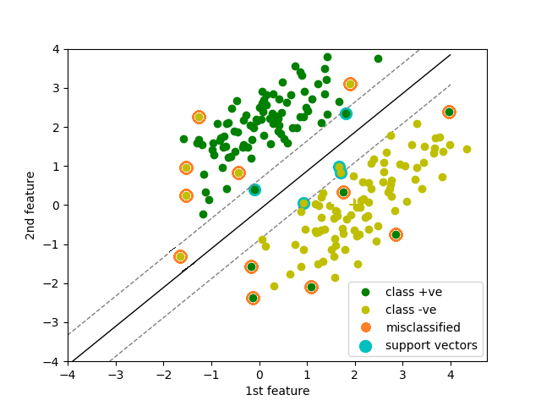
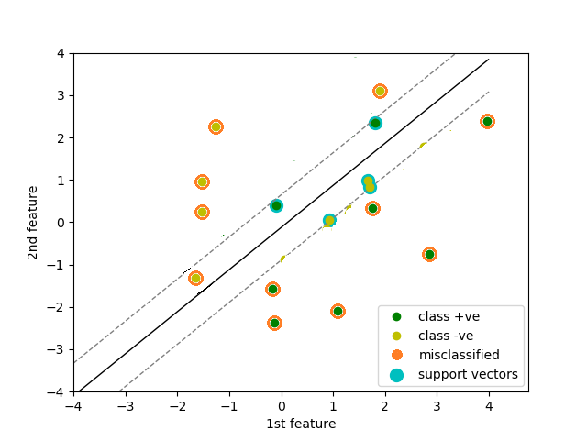
Misclassified Only
Notes:
This idea can again be visualized in the following figures. The figure on the left is an example of the result of training on the first batch of data whose support vectors are marked in turquoise. The support vectors are then used to predict the labels of this batch of data and the resultant incorrectly classified points are depicted in orange. The figure on the right denotes the resultant density of the dataset when we eliminated all points except the previous support vectors and the misclassified points. This method actually immensely reduced the number of points considered for training but this came at a cost of drop in accuracy of classification. This left us with a tradeoff between accuracy and computation time and complexity. Following this we thought out a final method that would help boost the classification accuracy while keeping the density of the training dataset to a minimum.
Reducing the number of datapoints results in computational complexity decreases.

Slide 18
Misclassified + Marginal
+ marginal points
Notes:
The fourth method involved steps similar to the previous algorithm where the initial batch is trained, the model is then used to predict the labels of the consequent batches. In addition to selecting those points that were misclassified, we also define a new margin or boundary which is adjacent to the already existing one, and consider points that lie within this region too for training.

Slide 19
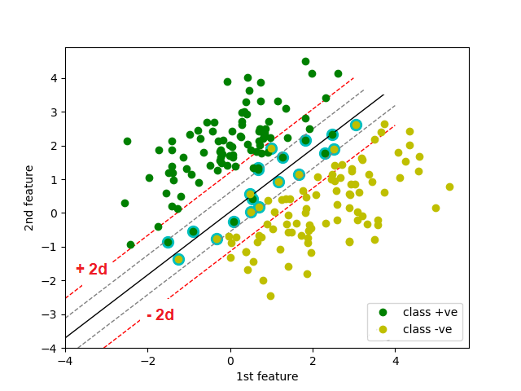
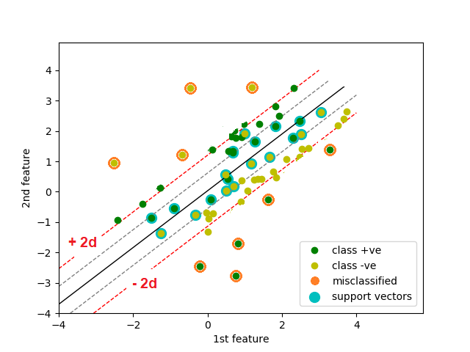
Misclassified + Marginal
Notes:
This can be seen as an example in the following figures. The figure on the left indicates the resulting support vectors from the first batch of data, the misclassified samples from the second batch of data and the new boundary defined in red adjacent to the existing boundary. This can be seen as an inspiration from our nearest neighbor algorithm dThe second figure then denotes the dataset density after having discarded all samples except the support vectors from the previous batch, misclassified and marginal samples from the current batch. This algorithm came the closest in performance to the Baseline incremental and hence was chosen as our final algorithm.

Slide 20
Outline
Introduction
Incremental Algorithms
Algorithm Evaluation Results
Hardware Accelerator Design
Hardware Acceleration Results
Conclusion and Future work
Notes:
We can now proceed to take a look at how all our algorithms compare in a comparison of the classification accuracy.

Slide 21
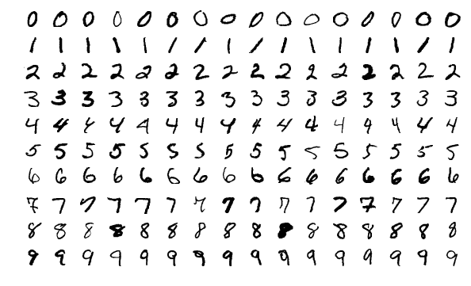
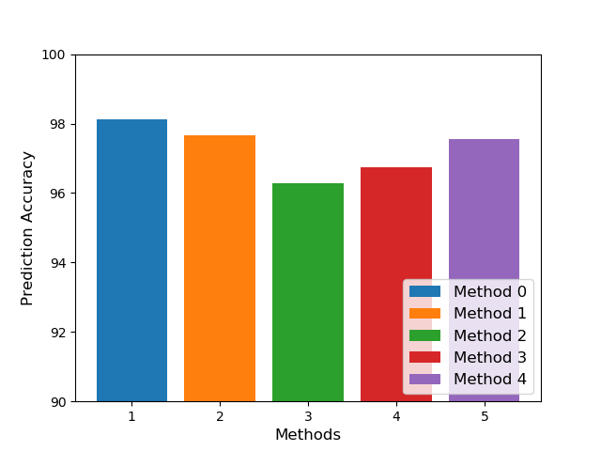
Prediction Accuracy
MNIST dataset results
98.13
97.65
97.55
96.28
96.75
Method 0 – Non Incremental
Method 1 – Baseline Incremental
Method 2 – Nearest - Neighbor approximation
Method 3 – Misclassified samples only
Method 4 – Misclassified + Marginal samples
Notes:
The Non incremental algorithm had a prediction accuracy of 98% whereas our baseline incremental came close at 97.65%. The Baseline incremental classification accuracy is what we are aiming to reach and it is clear that the final method of misclassified + marginal points comes very close at 97.55%.
It is not possible to run the non incremental since the board immediately runs out of memory

Slide 22
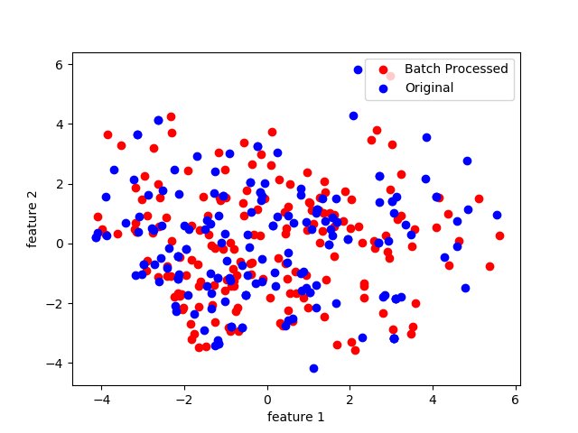
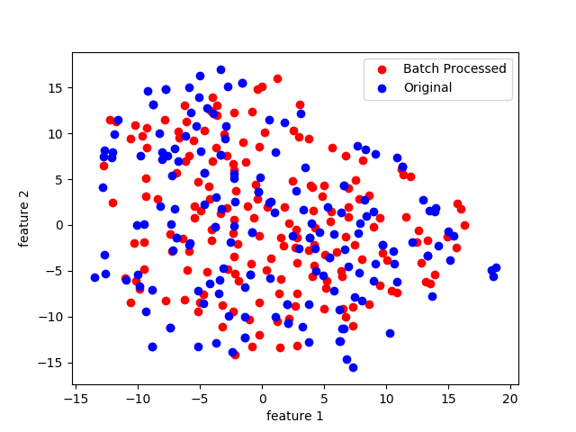
PCA and t-SNE
PCA plot for Label 0
t-SNE plot for Label 0
Training Samples
Support vectors
Training Samples
Support vectors
Notes:
As an initial method to compare the Features of the Training samples versus the features of the support vectors produces, two methods were considered for this purpose, both of which can provide a visual representation of the closeness of the points to each other. But then it was found that the distances between the points are not usually maintained during the transformation for high dimensional representation and hence other concrete methods were researched.

Slide 23
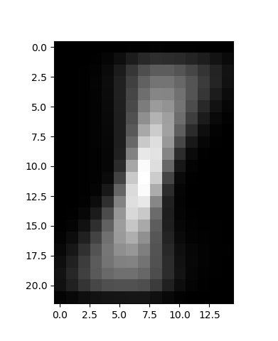
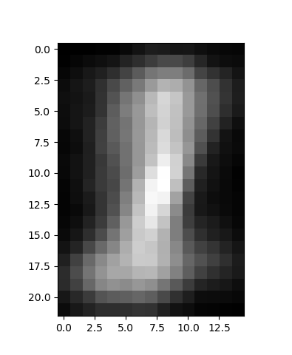
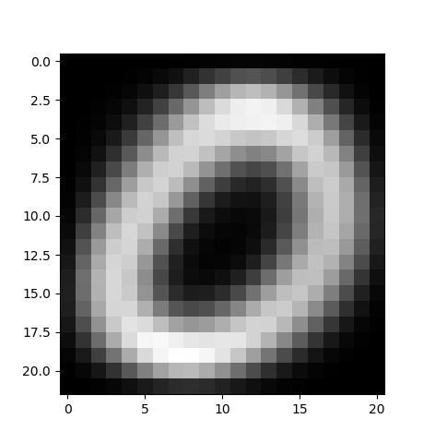
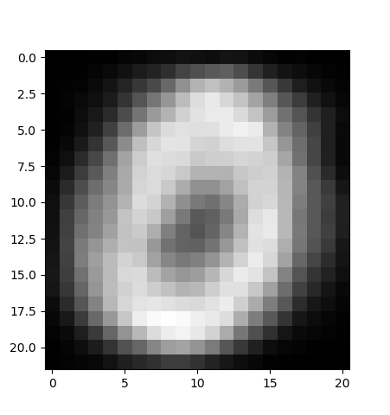
Feature Average Plot
Label 0
Label 1
Notes:
In addition to the Classification accuracy, a few other methods were researched in order to quantify the quality of our algorithm. The following figures represent the averages of the features of the training samples vs the average of the features of the support vectors. Remember our initial statement that the support vectors are a sufficient subset of samples from the original training set to completely define a particular label when it comes to prediction. In short, the more the feature average plot of our support vectors resembles that of the feature average plot of the training samples, the better our algorithm is in terms of the quality of support vectors produced. These are two examples from labels 0 and 1 of the famed MNIST dataset.

Slide 24
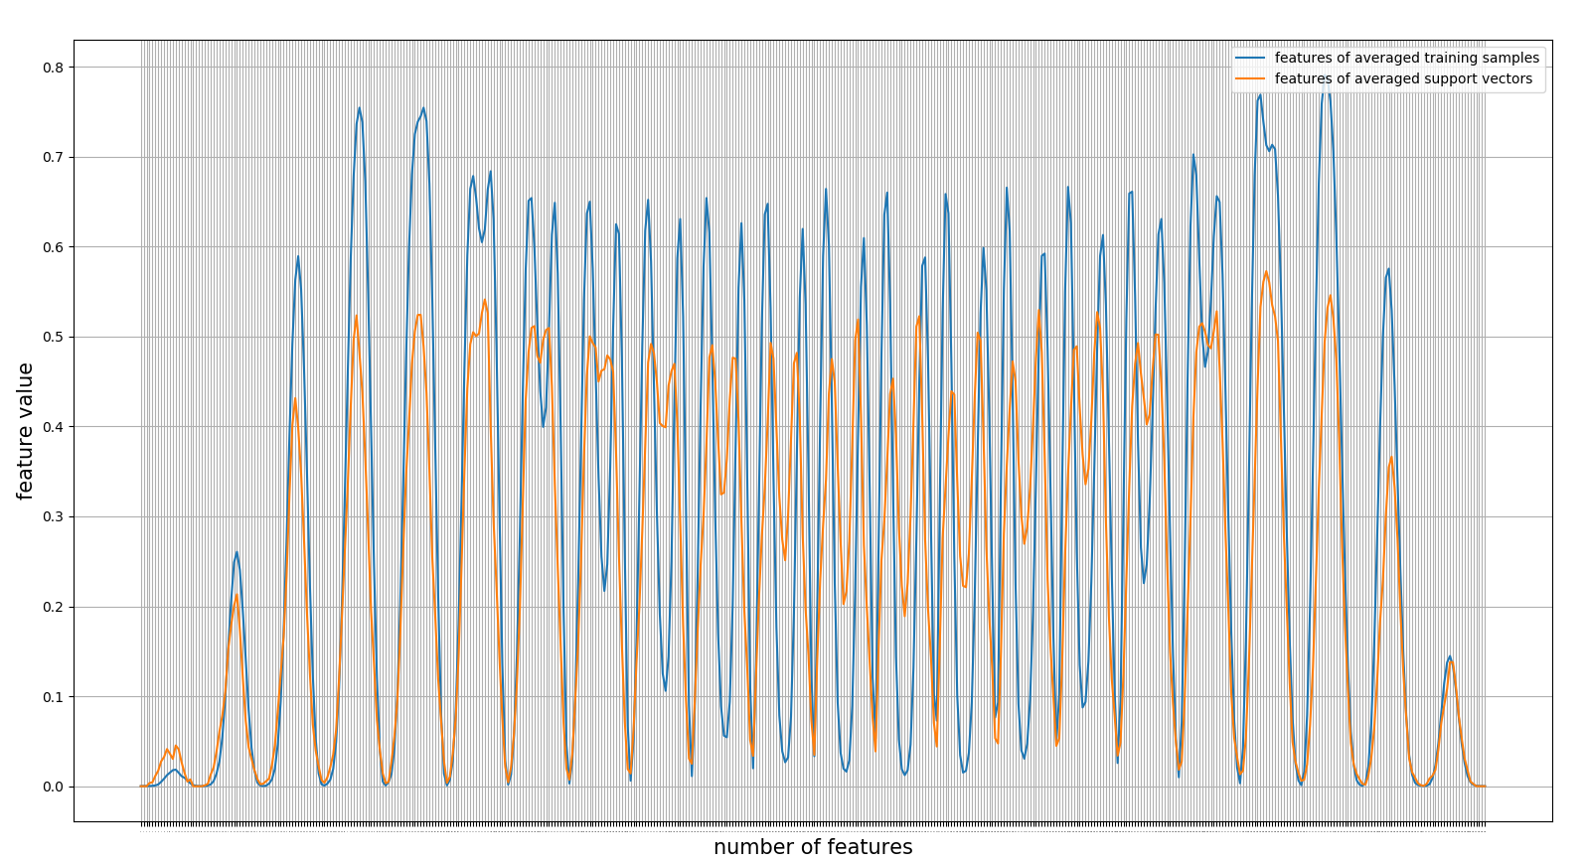
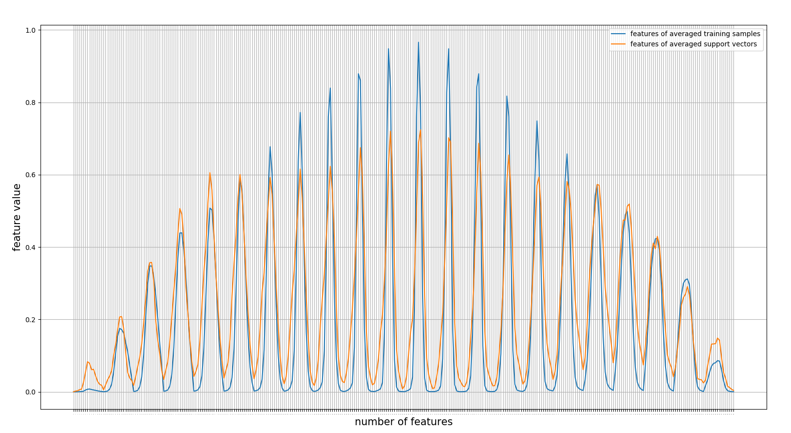
Parallel Coordinate Plot
Label 0
Label 1
Notes:
Similar to the previous quantification, here we consider the parallel coordinate system of representation of multi dimensional vectors, where here each dimension represent the feature of our sample. Here in this particular case there are 784 y axes which correspond to 784 features of each sample of our MNIST dataset. Again our aim is that the parallel coordinate plot of the average of the support vectors comes close to the parallel coordinate plot of the average of the training samples. This is an example for the label 0 and

Slide 25
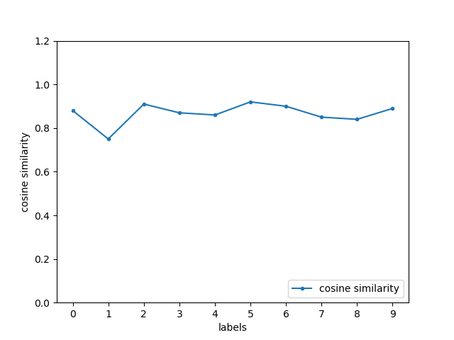
Cosine Similarity
Notes:
Following the previous two so to say visual methods of comparison, we proceed to see a statistical method of comparison of the support vectors produced by the algorithm vs the training samples used. The similarity measure used is known as the cosine similarity which calculated the cosine angle between the support vectors and the training samples. By the cosine table values, a value of 1 indicates complete similarity or an ange of 0 degrees between them and a value of 0 indicated complete dissimilarity between them,.

Slide 26
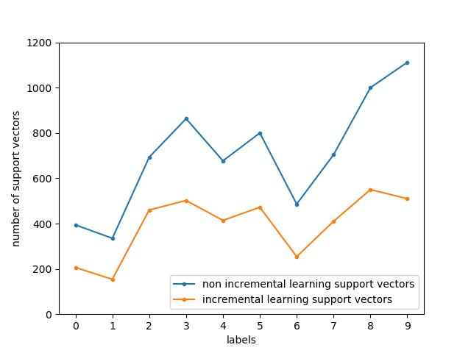
Number of Support vectors
Notes:
The final graph denoted the number of support vectors produced by our final approximated incremental method vs the original non incremental algorithm. We can see that for a reduced number of support vectors the algorithm performs just as well as the non incremental counter part, which is if importance when it comes to storing a large number of support vectors for inference stage due to memory constraints.

Slide 27
Outline
Introduction
Incremental Algorithms
Algorithm Evaluation Results
Hardware Accelerator Design
Hardware Acceleration Results
Conclusion and Future work
Notes:
We now proceed to discus with the aforementioned knowledge, a hardware accelerator design for our incremental approximated algorithm.

Slide 28
Algorithm Overview
.
.
.
SMO
KKT Conditions
Compute Kernel Matrix
Predict Incoming Samples with Support Vectors
Check Optimality Criteria
Obtain Support Vectors
.
.
.
Notes:
The algorithm consists of amongst other thing, two important phases now. Within every training phase, we have a regular training phase and also a prediction phase to select the misclassified samples. This structure comes in handy when we look at the profiling results of our algorithm,.

Slide 29
Profiling
ncalls | tottime | percall | cumtime | percall | function
8684 | 150.375 | 0.017 | 3003.453 | 0.346 | kernel_matrix
52 | 7.938 | 0.153 | 3013.406 | 57.950 | smo
10 | 147.332 | 0.245 | 2214.441 | 59.45 | predict
ncalls: number of calls
tottime: total time spent in the given function
percall: tottime/ncalls
cumtime: cumulative time spent in this and all subfunctions
percall: cumtime/ncalls
Notes:
As a first step, the algorithm was subject to a profiling where we noticed that the two functions that we called the most often and took the longest CPU timeare the kernel function and the predict function. Hence we proceed to select these two function for an FPGA based implementation for an attempt at accelerating the training process.

Slide 30
Hardware Accelerator Architecture
PYNQ
CPU
Jupyter Notebook
FPGA
AXI DMA Stream
SVM Algorithm
Kernel Function
Kernel Function
AXI DMA Stream
Predict Function
Predict Function
Notes:
The hardware accelerator is design as such. The PYNQ platform encompasses originally the Jupyter notebook that houses our SVM algorithm that is a CPU only implementation. We identified that the Kernel function and the predict function we the two most computationally intensive aspects of the algorithm and hence moved these implementations from the CPU to the FPGA. The communication protocol used was a high speed DMA AXI stream.

Slide 31
Kernel Function
def kernel_matrix(self, X, index): result = np.zeros(X.shape[0]) x_i = X[index, :] for j, x_j in enumerate(X): result[j] = self.kernel(x_i, x_j) return result
class kernels(object): @staticmethod def rbf(gamma): def f(x, y): exponent = - gamma * np.linalg.norm(x-y) ** 2 return np.exp(exponent) return f
Kik = self.kernel_matrix(X, i)
Kjk = self.kernel_matrix(X, j)
Notes:
The kernel function actually gets called twice in the algorithm for every fun in two different spots. the nature of the computations in the function are basically persistent subtraction and multiplication which are ripe candidates for the parallelization ability of an FPGA. Implemented as a callable library for use in any ML algorithm that uses this kernel, This was the first of two functions that were accelerated using the FPGA. This function could now be directly called from the Jupyter notebook as one would call a standard library and could be used for acceleration.

Slide 32
Predict Function
def predict(self, X): n_samples = X.shape[0] prediction = np.zeros(n_samples) for i, x in enumerate(X): result = 0.0 for z_i, x_i in zip(self.dual_coef, self.support_vectors): result += z_i * self.kernel(x_i, x) prediction[i] = result return prediction
class kernels(object): @staticmethod def rbf(gamma): def f(x, y): exponent = - gamma * np.linalg.norm(x-y) ** 2 return np.exp(exponent) return f
Notes:
The second function is the predict function that involved mostly repetitive addition, multiplication or accumulation involving samples that needed to be predicted and the support vectors and dual coefficients that form the prediction model. along with the previous defined kernel function also coming into play. Once again the nature of these computations makes it a prime candidate to utilize the parallel computing capabilities of the FPGA.

Slide 33
Outline
Introduction
Incremental Algorithms
Algorithm Evaluation Results
Hardware Accelerator Design
Hardware Acceleration Results
Conclusion and Future work

Slide 34
Hardware Acceleration Results
Datasets | Size | Baseline Incremental |  |  | Misclassified Only |  |  | Misclassified + Marginal
 |  | Accuracy | Run time | Speed up | Accuracy | Run time | Speed up | Accuracy | Run time | Speed up
Forest Cover Type | 16,000 x 54 | 87.01% | 02:12:54 00:26:38 | 4.9 | 84.025% | 02:51:53 00:31:42 | 5.4 | 86.87% | 12:26:54 02:21:20 | 5.2
Letter Recognition | 20,000 x 16 | 94.36% | 01:05:11 00:05:35 | 11.7 | 93.20% | 00:59:21 00:06:26 | 9.2 | 94.39% | 03:12:47 00:10:02 | 19.2
NASA Shuttle Failure | 34,800 x 6 | 99.77% | 00:36:08 00:00:48 | 45.1 | 98.89% | 00:40:05 00:00:32 | 75.1 | 99.79% | 01:45:06 00:25:12 | 4.1
OTTO Group | 48,000 x 93 | 78.02% | 18:45:22 2:10:45 | 8.6 | 70.60% | 22:41:47 2:55:22 | 7.5 | 77.81% | 31:14:54 10:47:32 | 3.1
Sensorless Drive Diagnosis | 59,000 x 48 | 97.66% | 22:32:24 05:16:34 | 4.4 | 94.37% | 26:41:42 07:32:14 | 3.7 | 95.98% | 35:51:23 14:25:23 | 2.5
MNIST | 60,000 x 784 | 98.13% | 17:25:13 02:56:27 | 2.1 | 96.75% | 20:54:24 03:45:35 | 6.6 | 97.55% | 28:24:12 08:21:15 | 3.4
Fashion MNIST | 60,000 x 784 | 87.42% | 20:21:54 03:24:41 | 5.9 | 84.55% | 22:28:56 04:31:22 | 5.1 | 87.22% | 32:43:47 09:51:45 | 3.3
Notes:
The following table represents the results of our hardware acceleration for various commonly used datasets in the machine learning community. We represent the number of samples considered and compare results for our three Incremental methods. The run time on the top indicates the CPU only time and the one on the bottom indicated the Hardware accelerated. In all cases we can see that the prediction accuracy values of our final algorithm are very close to the baseline incremental implementation. Some points of interest are that in this particular dataset, we achieved very high acceleration speed up about 45 to 75 times. And along with this the other dataset we can observe that our final algorithm actually surpassed the accuracy of the baseline incremental.

Slide 35
Hardware/Software Runtime
Notes:
Sorted by no of samples

Slide 36
FPGA Speedup
Notes:
Sorted by number of features
There is an unstated rule saying that if the number of features lie withing the degree of the polynomial that is used in the kernel trick, the SVM performs very fast and its computation time increases non linearly with an increase in the number of features above this limit. This is due to the limitation of the number of samples that the FPGA can process at a time. The accelerator is implemented to tile and batch process the samples as well as the support vectors it needs in order to perform prediction and kernel computation and hence there is a drop in the speed up for datasets with a larger number of features.

Slide 37
Outline
Introduction
Incremental Algorithms
Algorithm Evaluation Results
Hardware Accelerator Design
Hardware Acceleration Results
Conclusion and Future work

Slide 38
Conclusion and Future work
Achieved Objectives:
Incremental implementation of the SVM algorithm
Approximating the computations of the algorithm
Accelerating both training and inference stages of the algorithm
Future Work:
Methods to decrease the number of support vectors
Perform entire training on the FPGA
More BRAM would allow for larger amount of processing at once
Better design of accelerator using HDL languages

Slide 39

Thank you! Questions?
Notes:
Thank you.

